Slide 1

Data Types and Data Structures
Suvansan S.
Senior Software Engineer
Unicom SD

Slide 2
Prerequisites
Basic idea about web development
Basic knowledge about HTML
Basic knowledge about Java script

Slide 3
Learning Objective
String Number BigInt Boolean Array

Slide 4
String
Represents textual data enclosed within single or double quotes.
String Methods
String length: Returns the length of a string.
const str = "Hello, world!";
console.log(str.length); // Output: 13
String charAt() / String at() / String [ ]: Returns the character at a specified index in a string.
const str = "Hello";
console.log(str.charAt(1)); // Output: "e“
console.log(str.at(1)); // Output: "e“
console.log(str[1]); // Output: "e"

Slide 5
String slice() / String substring() / String substr(): Extracts a section of a string and returns it as a new string.
const str = "Hello, world!";
console.log(str.slice(0, 5)); // Output: "Hello“
console.log(str.substring(0, 5)); // Output: "Hello“
console.log(str.substr(0, 5)); // Output: "Hello“
String toUpperCase(): Converts a string to uppercase.
const str = "hello";
console.log(str.toUpperCase()); // Output: "HELLO“
String toLowerCase(): Converts a string to lowercase.
const str = "HELLO";
console.log(str.toLowerCase()); // Output: "hello“
String concat(): Concatenates one or more strings and returns a new string.
const str1 = "Hello";
const str2 = "World";
console.log(str1.concat(", ", str2)); // Output: "Hello, World"

Slide 6
String trim(): Removes whitespace from both ends of a string.
const str = " Hello, world! ";
console.log(str.trim()); // Output: "Hello, world!“
String repeat(): Returns a new string containing the specified number of copies of the original string.
const str = "Hello";
console.log(str.repeat(3)); // Output: "HelloHelloHello“
String replace(): Replaces a specified value or pattern in a string with another value.
const str = "Hello, world!";
console.log(str.replace("world", "Universe")); // Output: "Hello, Universe!“
String split(): Splits a string into an array of substrings based on a specified separator.
const str = "apple,banana,grape";
console.log(str.split(",")); // Output: ["apple", "banana", "grape"]

Slide 7
String Search
String indexOf() / String search(): : Returns the index within the calling String object of the first occurrence of the specified value, starting the search at fromIndex. Returns -1 if the value is not found.
const str = "Hello, world!";
console.log(str.indexOf("world")); // Output: 7
String includes(): Determines whether one string may be found within another string.
const str = "Hello, world!";
console.log(str.includes("world")); // Output: true
String startsWith(): Determines whether a string begins with the characters of another string, returning true or false as appropriate.
const str = "Hello, world!";
console.log(str.startsWith("Hello")); // Output: true

Slide 8
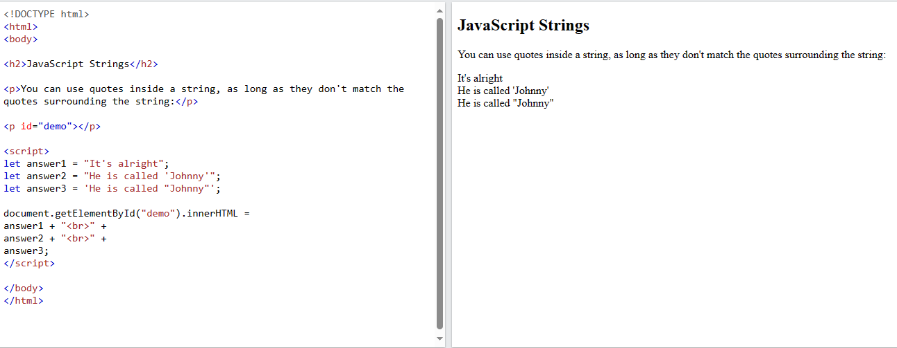

Slide 9
Number
Represents numeric data, including integers and floating-point numbers.
let x = 3.14; // A number with decimals let y = 3; // A number without decimals
let y = (0.2*10 + 0.1*10) / 10;
console.log(y);

Slide 10
Number Methods
toString(): Returns a number as a string.
const num = 42;
console.log(num.toString()); // Output: "42“
toFixed(): Returns a number written with a fixed number of decimals.
const num = 3.14159;
console.log(num.toFixed(2)); // Output: "3.14"
toPrecision(): Returns a number written with a specified length.
const num = 3.14159;
console.log(num.toPrecision(3)); // Output: "3.14“
valueOf(): Returns a number as a primitive value (number).
const num = 42;
console.log(num.valueOf()); // Output: 42

Slide 11
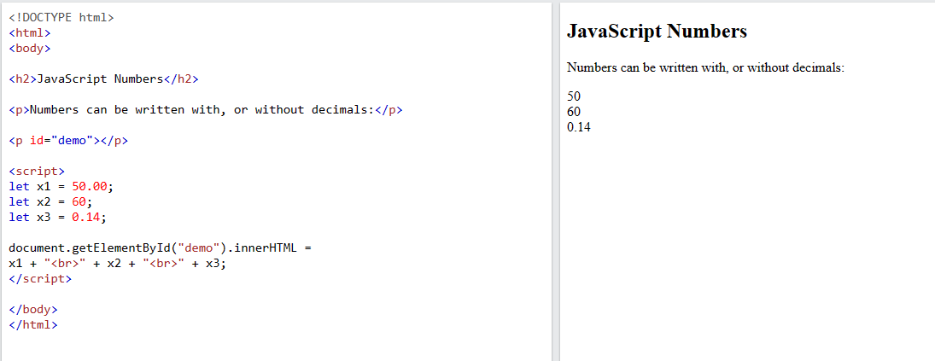

Slide 12
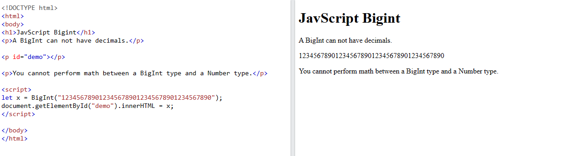

Slide 13
Boolean
Represents a logical value indicating either true or false.
data type that can only have one of two values, like
YES / NO
ON / OFF
TRUE / FALSE
For this, JavaScript has a Boolean data type. It can only take the values true or false.

Slide 14
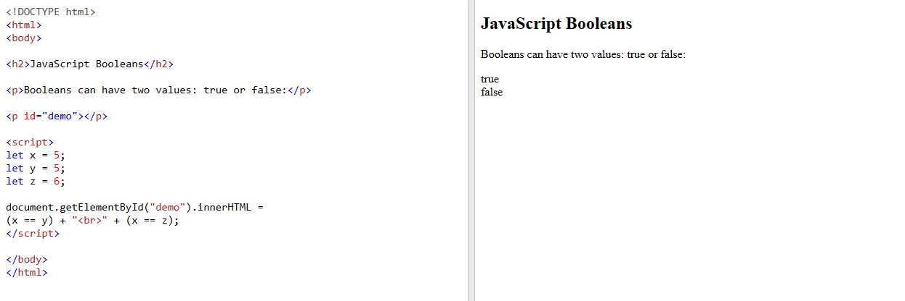

Slide 15
Data Structure
JavaScript supports several built-in data structures that can be used to organize and manipulate data efficiently. Here's an overview of some common data structures in JavaScript:
Arrays
const array = [1, 2, 3];
Objects
const person = { name: "John", age: 30, city: "New York" };
Sets
const set = new Set([1, 2, 3, 2, 1]);
Maps
const map = new Map();
map.set("name", "John");
map.set("age", 30);
Stacks
Queues
Linked Lists

Slide 16
Arrays
Arrays in JavaScript are used to store multiple values in a single variable. They are declared using square brackets [].
const cars = ["Saab", "Volvo", "BMW"];
const cars = new Array("Saab", "Volvo", "BMW");
const fruits = ["Banana", "Orange", "Apple", "Mango"];
document.getElementById("demo").innerHTML = fruits.toString();

Slide 17
Array length: Returns the number of elements in an array.
const array = [1, 2, 3, 4, 5];
console.log(array.length); // Output: 5
Array toString(): Converts an array to a string by joining all elements with commas.
const array = [1, 2, 3];
console.log(array.toString()); // Output: "1,2,3“
Array at(): There's no Array.at() method in JavaScript. It seems you might have mistaken it with other methods like Array[index] for accessing an element at a specific index.
const array = ["apple", "banana", "orange"]; // Accessing the element at index 1 console.log(array[1]); // Output: "banana“
console.log(array.at(1)); // Output: "banana“
Array join(): Joins all elements of an array into a string using a specified separator.
const array = ["apple", "banana", "orange"];
console.log(array.join(" - ")); // Output: "apple - banana - orange“

Slide 18
Array pop(): Removes the last element from an array and returns that element.
const array = ["apple", "banana", "orange"];
array.pop();
console.log(array); // Output: ["apple", "banana"]
Array push(): Adds one or more elements to the end of an array and returns the new length of the array.
const array = ["apple", "banana"];
array.push("orange", "grape");
console.log(array); // Output: ["apple", "banana", "orange", "grape"]
Array splice(): Changes the contents of an array by removing or replacing existing elements and/or adding new elements in place.
const array = [1, 2, 3, 4, 5];
console.log(array.splice(1, 2)); // Output: [2, 3]
console.log(array); // Output: [1, 4, 5]
Array delete(): There isn't an Array.delete() method in JavaScript. Instead, you can use the delete operator to delete elements from an array, but it leaves a gap.
const array = [1, 2, 3];
delete array[1];
console.log(array); // Output: [1, empty, 3]

Slide 19
Array slice(): Returns a shallow copy of a portion of an array into a new array object.
const array = [1, 2, 3, 4, 5];
console.log(array.slice(1, 3)); // Output: [2, 3]
Array concat(): Combines two or more arrays.
const array1 = [1, 2];
const array2 = [3, 4];
const newArray = array1.concat(array2);
console.log(newArray); // Output: [1, 2, 3, 4]
Array indexOf(): Returns the first index at which a given element can be found in the array, or -1 if it is not present. It searches the array from the beginning.
const array = [1, 2, 3, 4, 5];
console.log(array.indexOf(3)); // Output: 2
console.log(array.indexOf(6)); // Output: -1 (not found)
Array includes(): Determines whether an array includes a certain value among its elements, returning true or false as appropriate.
const array = [1, 2, 3, 4, 5];
console.log(array.includes(3)); // Output: true
console.log(array.includes(6)); // Output: false

Slide 20
Array sort(): Sorts the elements of an array in place and returns the sorted array. By default, the elements are sorted as strings in ascending order.
const array = [3, 1, 2];
array.sort();
console.log(array); // Output: [1, 2, 3]
You can also provide a compare function to define the sorting order:
const array = [3, 1, 2];
array.sort((a, b) => a - b); // Ascending order
console.log(array); // Output: [1, 2, 3]
array.sort((a, b) => b - a); // Descending order
console.log(array); // Output: [3, 2, 1]
Array reverse(): Reverses the elements of an array in place and returns the reversed array.
const array = [1, 2, 3];
array.reverse();
console.log(array); // Output: [3, 2, 1]

Slide 21
Thank you

